Slide 1


Using Machine Learning to Reduce Food Wastage and Fight Hunger
Guruprasad Velikadu Krishnamoorthy

Slide 2
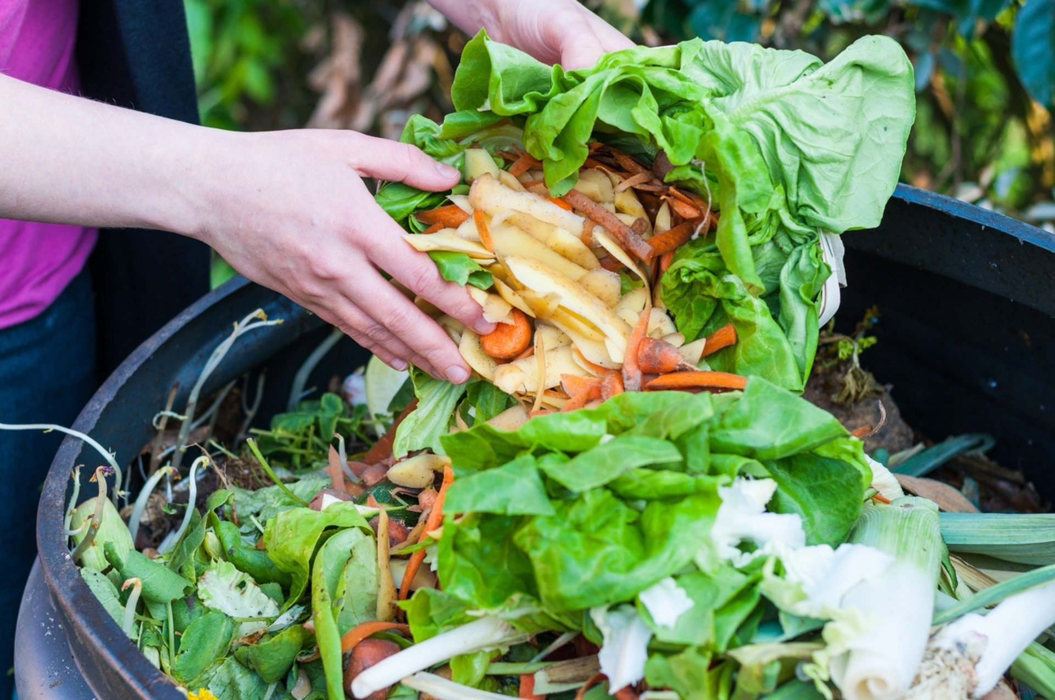
Why is Food Wastage a Problem?
Monetary loss:
In 2022, about 38% of Food produced in the U.S. was wasted which is almost USD 161 Billion. On average, in the U.S. a person wastes $370 worth of food annually, which is almost $1500 for a family of four.
Wastage of Resources:
Food wastage also includes the time, water, labor, and effort spent on farming, transportation, storage, and food distribution.
Impacts to Climate:
Food waste is the largest source of Methane emissions in the landfills, thus contributing to the Global warming and Air pollution.

Slide 3
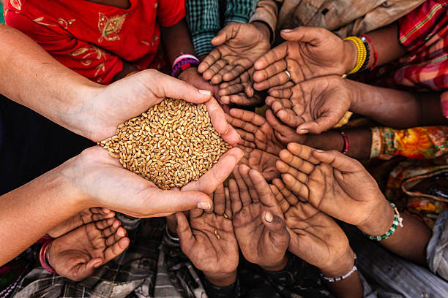
How can Machine Learning help?
In 2022, 44 Million people in the U.S. were food insecure including 5 million Children who did not have access to Nutritious meals.
According to the Food Security and Nutrition report, about 783 million people faced hunger in 2022, representing almost one-tenth of the world's population and an increase of 122 million from 2019.
Machine Learning can help close the Gap between excess Food production and hunger, by building a model to predict the amount of food wasted, thereby reducing the excess production.
Also, Implementing innovative solutions such as Enhancing Food distribution, Intelligent routing, and Recycling food, the Food donation can be improved.

Slide 4

Steps involved in the Machine learning Model Building
Unsupervised Algorithm
Semi-Supervised Algorithm
Reinforcement Algorithm
Supervised Algorithm
1. Extracting the Data
2. Exploratory Data Analysis
3. Data Wrangling & Preparation
4. Feature Engineering for Model Building
5. Evaluating the Model Performance

Slide 5
Data Sources and Extraction
# | Dataset Name | Type | Dimensions | Description
1 | Surplus Food Detail Dataset | CSV File | 560k Rows and 28 Columns | The Primary dataset contains details of food wasted, donated, and other characteristics at the state level from 2010 to 2022.
2 | Surplus Food Summary Dataset | CSV File | 163k Rows and 16 Columns | This dataset contains the summary of excess food production in the US from 2010 to 2022.
3 | US Population Dataset | Excel File | 51 Rows and 5 Columns | It Contains US Population data for each state from 2020 to 2023
4 | US Poverty Rate Dataset | Excel File | 51 Rows and 4 Columns | It Contains US Poverty Rate data for each state from 2020 to 2022
5 | US Homelessness Dataset | Excel File | 51 Rows and 2 Columns | It Contains Homelessness in the US in 2022 for each state.

Slide 6
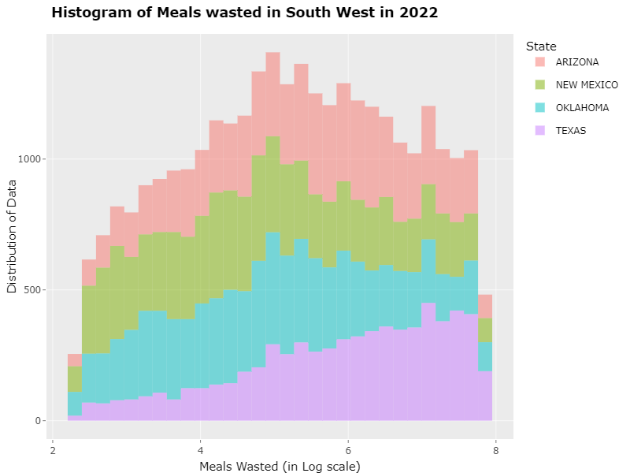
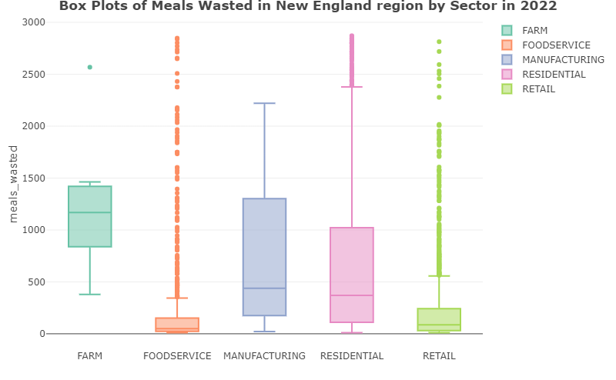
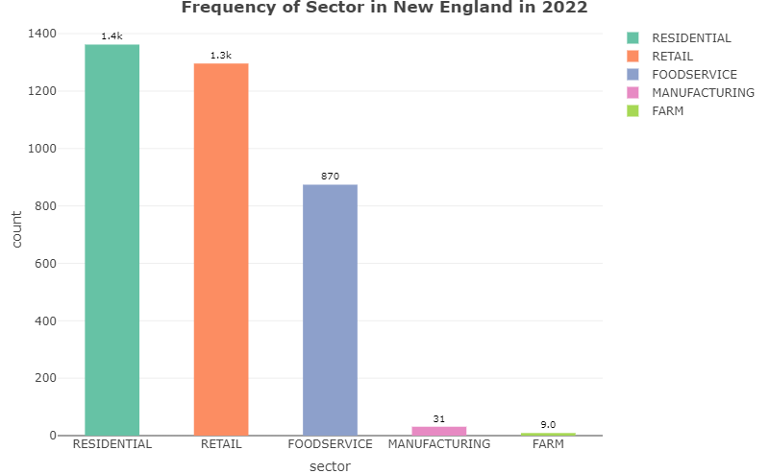
Exploratory Data Analysis
In this phase, the Summary statistics, the data distribution, the number of observations, and Outliers were identified by plotting the box plot, Bar plot, and Histogram.
The Distribution of the data was not even across all the sectors, also Outliers were found across most sectors.
The relationship of the target variable with other features was also identified and the features that have strong relation with the meals wasted variable were identified.

Slide 7

Data Wrangling & Preparation
Null/ Missing values Validations, Duplicate Checks
Identifying the Data format inconsistencies & Data types
Fixing the Capitalizations, special characters, etc.
Identifying and Handling the Outliers.
Comparing the Unique values between the datasets
Join the datasets based on common columns
Create dummy variables for String/Factor variables.
1
2
3
4
5
6
7

Slide 8
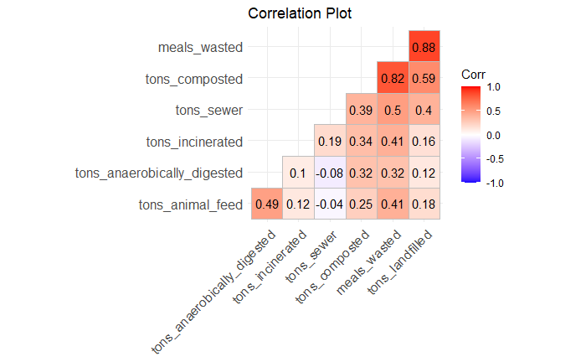
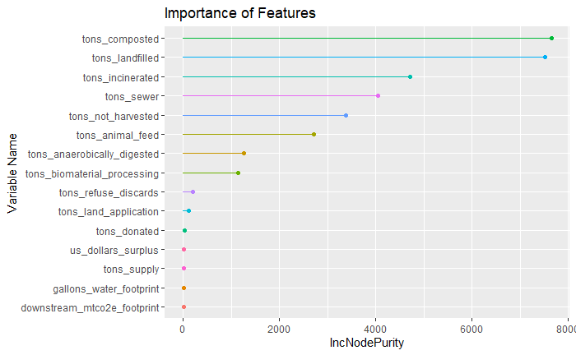
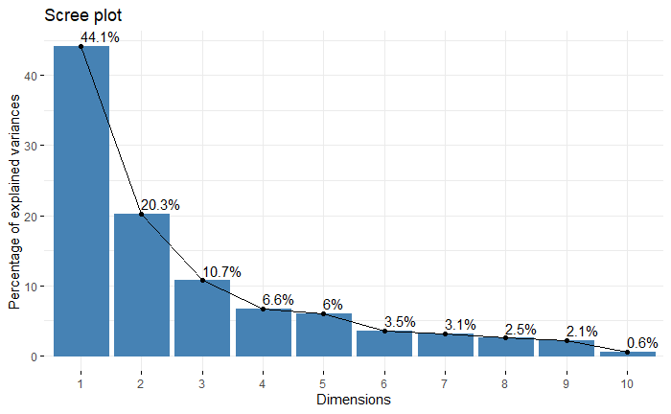
Feature Engineering for Model Building
The number of numeric features was reduced by the below methods:
Eliminating the variables that were highly correlated.
Eliminating the features with p-value > 0.05 that may not be significant.
Identifying and Retaining the Features that are important for Model building.
Using Principal Component Analysis(PCA) to retain a few variables without losing much of the data.

Slide 9
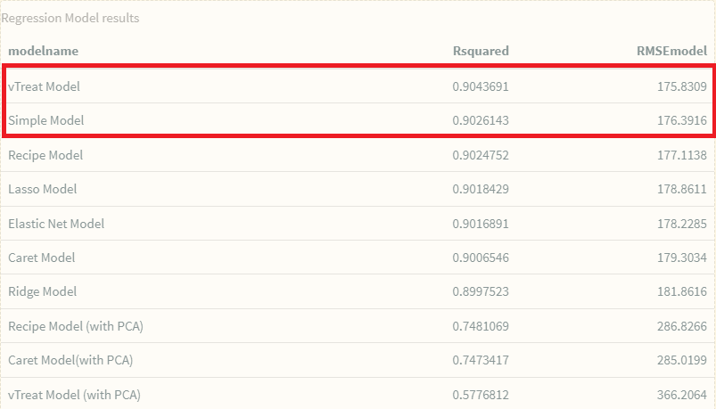
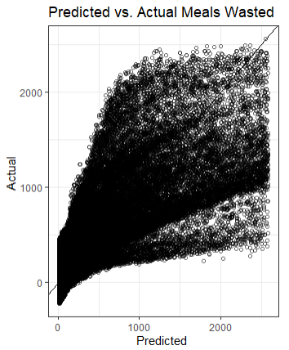
Model Building & Evaluation
Various Regression algorithms such as Linear Regression using caret, vTreat, and Recipe packages and regularized Regression such as Ridge, Lasso, and Elastic Net were trained on the dataset to predict the target variable- meals wasted.
To avoid the problem of overfitting, the K-fold cross-validation and hyperparameter tuning were performed to find the optimal set of parameters for the model.
The performance of most of the models was similar and they all had close R-squared and RMSE values.
vTreat and Simple Regression models had the best performance scores as shown in the table.
The Models were also tested for Multicollinearity and Homoscedasticity

Slide 10

Implementation Plan & Recommendations
Before deploying the Model in production, it must be tested in production-like simulation environments to assess its performance.
A web interface or an app using Streamlit can be built that takes the user input, such as the state, sector, subsector, food type, and season, and the Model can predict the amount of Food that may be wasted for that category.
Solutions such as Intelligent rerouting, Optimizing the harvest, and enhancing food distribution & storage to reduce food wastage can be added as an improvement.
The Model can expand further by including the time component, such as year and month, to predict food wastage for a specific period of the year.

Slide 11
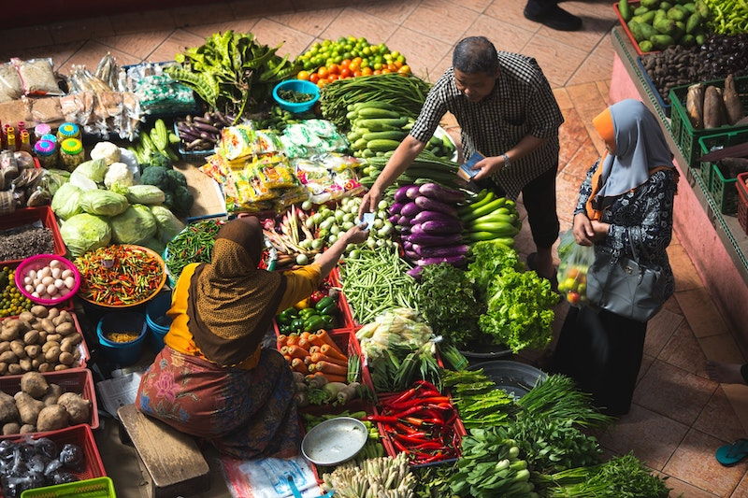
Challenges & Ethical concerns
The freshness aspect of Food is not included in the model
The Model treats all types of food alike and cannot differentiate the healthy vs Junk food.
Though the project intends to reduce the surplus food production and increase food donations to the poor and hungry, they are only meant to complement each other and not to cause conflicts.
Though donating Food by reducing food wastage is a great cause, care must be taken to refrain from donating expired or near-expiry Food. Local laws must be followed, and proper licenses must be secured to avoid conflicts with local government policies.

Slide 12
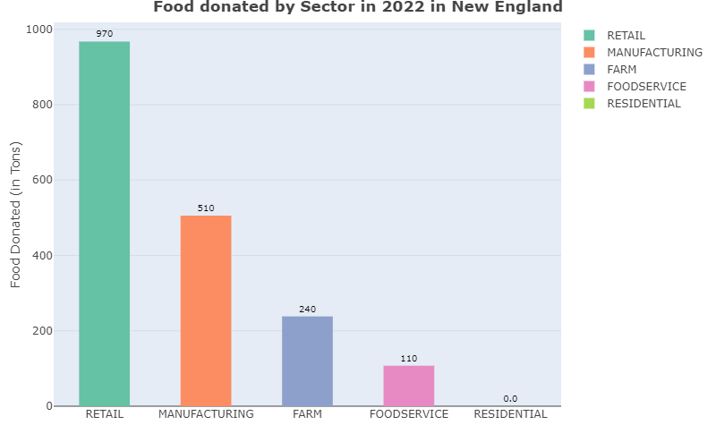
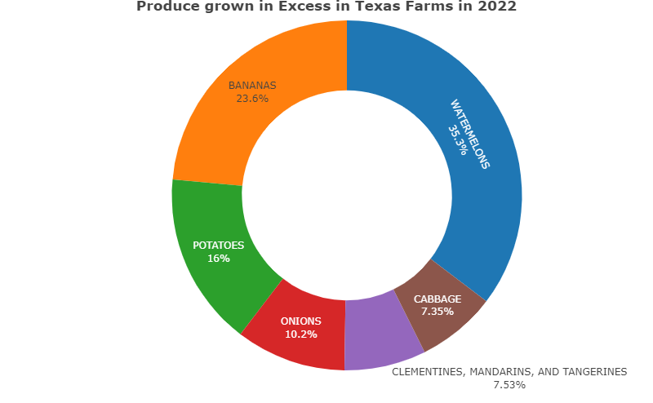
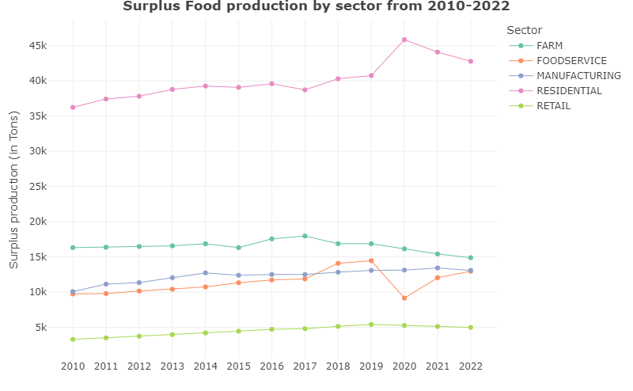
Further Analysis
What was the U.S. surplus food production trend over the years?
Which produce was the most grown in Surplus in Texas Farms in 2022?
Which state wasted the most Food, and which sectors in 2022?
Notes:
Which state wasted the most Food, and which sectors in 2022?

Slide 13
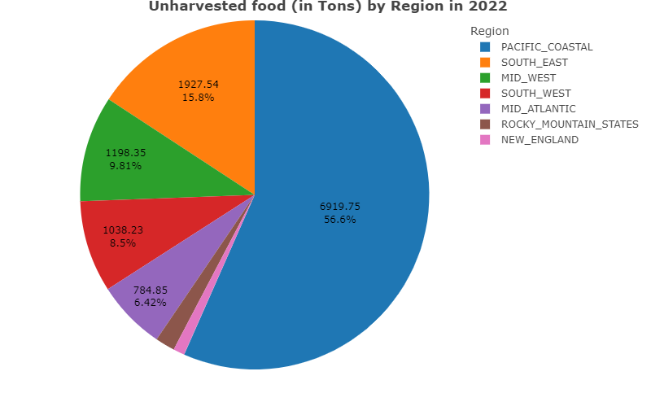
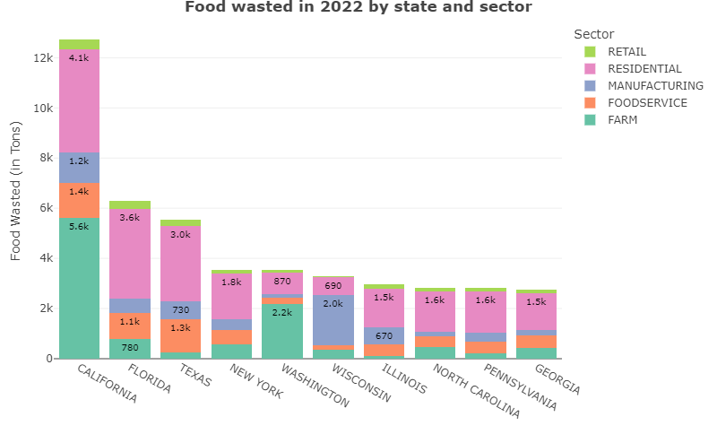
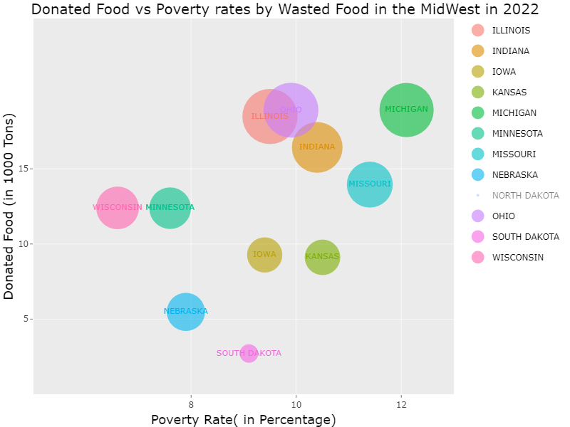
Further Analysis (continued)
Which region wasted the most unharvested food?
Which sector donated the least amount of Food?
Which Midwest state had the highest poverty rate and how much food was donated in 2022?

Slide 14
References
https://www.feedingamerica.org/hunger-in-america
https://refed.org/food-waste/the-problem
https://www.census.gov/data.html
https://www.rts.com/resources/guides/food-waste-america/
https://www.usda.gov/foodlossandwaste/why#:~:text=Resources%20could%20be%20conserved%20for
https://www.un.org/en/global-issues/food#:~:text=Food%20security%20and%20nutrition%20situation%20remains%20dire%20in%202022&text=According%20to%20the%202023%20edition

Slide 15

Thank You!

